Slide 1
Destroying The Yoke
With Prosperity

Slide 2
AGENDA
Overview
Full circle on some visions
Destroying the Yoke With Prosperity
The Necessity of Desire
Hesitation: The Silent Dream Killer
Q & A

Slide 3
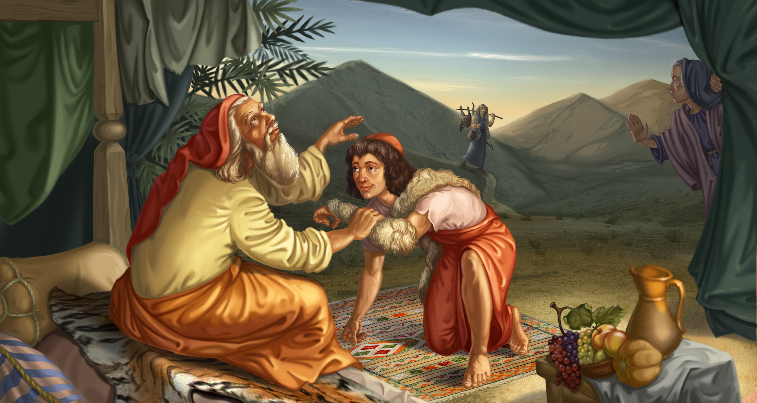
The Stolen Blessing
“And may God give you of the dew of the heavens and of the fatness of the earth and abundance of grain and [new] wine; Let peoples serve you and nations bow down to you; be master over your brothers, and let your mother’s sons bow down to you. Let everyone be cursed who curses you and favored with blessings who blesses you.” Genesis 27:28-29

Slide 4
The Promise To Break The Yoke
The blessing Esau received…
“Behold, your dwelling shall be of the fatness of the earth, and of the dew of heaven from above. By your sword you shall live, and you shall serve your brother; And it shall come to pass, when you become restless,
Literally: (“when thou shall have dominion”) When you’ve finally had enough and are ready to take charge, to rule, be free, to travel without restriction, to roam. Go where you want, when you want. Genesis 27:39-40

Slide 5
The Promise To Break The Yoke
“When you become restless and are ready to have dominion, then you shall break his yoke from your neck.” Genesis 27:39-40
Esau became quite wealthy and came to meet Jacob and had 400 men under his leadership. And had abundance.

Slide 6
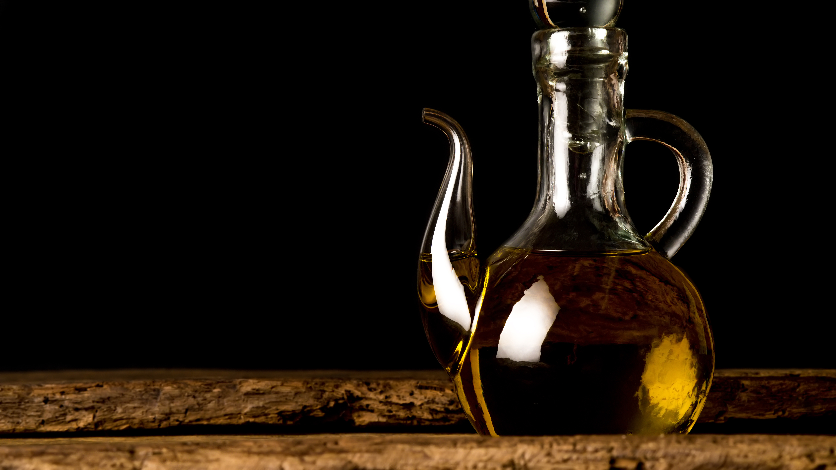
How is the Yoke Destroyed?
“And at that day shall his burden (Assyrians) be taken away from off thy shoulder, and his yoke from off thy neck: and the yoke shall be destroyed because of the anointing.” (Isaiah 10:27)
SHEMEN: Almost always translated as “oil”, as in olive oil.

Slide 7
“Shemen” (Olive Oil) A Symbol of Abundance
Physical oil will not destroy a wooden yoke. In fact, oil preserves wood.
The words “yoke” and “oil” (shemen) are used metaphorically.
“And at that day shall his burden be taken away from off thy shoulder, and his yoke from off thy neck: and the yoke shall be destroyed because of the oil.”

Slide 8
“Shemen” (Olive Oil) A Symbol of Abundance
Doesn’t make sense unless you understand that…
Oil was considered liquid gold and was the backbone of the import-export trade in the ancient world.
Used as prize money in ancient Olympics.
Best runner got 2500 kilos of high quality oil (almost 5 years wages)
Winner of the chariot race got 5000 Kilos (close to 10 years wages)

Slide 9
Elisha Multiplies Oil To Produce Wealth
A certain woman of the wives of the sons of the prophets cried out to Elisha, saying, “Your servant my husband is dead…, and the creditor is coming to take my two sons to be his slaves.”
So Elisha said to her, “What shall I do for you? Tell me, what do you have in the house?” And she said, “Your maidservant has nothing in the house but a jar of oil.”

Slide 10
Elisha Multiplies Oil To Produce Wealth
Then he said, “Go, borrow vessels from everywhere, from all your neighbors—empty vessels; do not gather just a few. And when you have come in, you shall shut the door behind you and your sons; then pour it into all those vessels, and set aside the full ones.”
“Go, sell the oil and pay your debt; and you and your sons live on the rest.”

Slide 11

Destroy The Yoke With Prosperity “There is desirable treasure, and oil in the dwelling of the wise, but a foolish man squanders it.” (Proverbs 21:20)
“And it hath come to pass, in that day, Turned is his burden from off thy shoulder, And his yoke from off thy neck, And destroyed hath been the yoke… BECAUSE OF PROSPERITY” (Isaiah 10:27 YLT)
THINK ABOUT THAT…

Slide 12
Destroy The Yoke Esau’s dwelling was going to be the fatness (root word = SHAMAN: to become fat) of the earth and the dew from heaven.
There’s going to come a time, when you realize, you don’t need to be in bondage anymore.
You’re ready to fly solo, to start your own venture, to build your dreams.
There comes a time when you burn the yoke. It has served its purpose.
People are enslaved to jobs they don’t want due to lack of prosperity.
It’s the oil of prosperity that breaks the yoke of slavery / bondage.
Prosperity is a key to getting free from bondage.

Slide 13

We Lose Wealth We Don’t Possess Internally Lottery winners lose all their money within 2 - 3 years. (Homeless man in Jacksonville)
The yoke was bondage (servitude - working for others / paying tribute) and it is oil (independent wealth) that breaks it.
So if prosperity is the key for getting free from bondage and throwing off the yoke, how do we become prosperous?
It’s a process, but it’s also instantaneous.
3 John 2: I wish above all things that you would prosper and be in health even as your soul prospers. Prosperity begins on the inside!

Slide 14
Wealth is a Thought (By Peter J. Daniels)
Some suggest that wealth is obtained by extensive education, but that is not borne out by those who have obtained and possess great wealth.
While it is necessary to obtain a sound basic education, it only requires a cursory investigation to observe that even business schools are unable to produce entrepreneurs.
Financial growth and stability has more to do with a pattern of thinking, good priority decision-making and disciplined action than with circumstances or social positioning.

Slide 15
“Wealth is a Thought” (By Peter J. Daniels)
To obtain wealth requires a special mindset that releases the imagination and drives the will.
The more you tend to insulate yourself from risk, the more you tend to insulate yourself from wealth.
Wealth seeker are always on the offensive and rarely on the defensive which requires a continued vigilant alertness to opportunity and awareness of impending danger.

Slide 16

Destroy The Yoke
Change your image on the inside so you see yourself in a different light. Take hold of the promises of God.
Remember the 10 spies... “We saw ourselves as grasshoppers and thus we were in their sight.” Numbers 13:33
You say, “I don’t have prosperity right now, how am I going to shake off the yoke?”

Slide 17
Destroy The Yoke
Grab hold of the Word now on the inside. Once you KNOW something and have it and possess it internally,.. In fact, you must possess it internally before you can grab a hold of it externally.
On your inside, you must see yourself taking hold of it on the outside. Judy told me to take “peace” and I did, and what a difference that made to me!
Take hold of the promise. Mark 11:22-24. When you believe what you say, you will have what you say. Believe that you receive (not just that you will receive) and you will have what you believe.

Slide 18
The Necessity of Desire

Slide 19
The Necessity of Desire
“Delight yourself also in the Lord, and He shall give you the desires of your heart.” (Psalm 37:4)
“Therefore, I say unto you, Whatever you desire, when you pray, believe that you receive them, and you shall have them.” (Mark 11:24)
“The desire of the righteous is only good (Proverbs 11:23) and will be granted.” (Proverbs 10:24)
“He will fulfill the desire of those who fear Him;” (Psalm 145:19)

Slide 20
The POWER of DESIRE
Desire is like a magnet.
But it doesn’t draw the thing desired to you, as much as it pulls you to the thing desired.
Desire draws you towards the object of your desire (James 1:14) so set your desires upon the Lord.
Make the Lord your chief desire and all other desires subservient to that.

Slide 21
Keep the Main Thing, the Main Thing
David wrote in Psalms 27:4 “ONE THING I have desired of the Lord, THAT will I seek: That I may dwell in the house of the Lord All the days of my life, to behold the beauty of the Lord, And to inquire in His temple.” David was very clear about what he wanted most, and he became forever known as a man after God’s own heart.
Later in life David wrote, “my eye has seen its desire upon my enemies.” (Psalm 54:7) Surely this included Goliath.

Slide 22
The Real LAW of ATTRACTION
“As long as King Uzziah (whose name means, “my strength is Jehovah”) frequented the presence of the Lord, requiring His presence, diligently seeking Him, beating a path to Him, carefully seeking and following Him, the Lord God Jehovah caused prosperity to rush to him, cutting a path to him like an unstoppable river, breaking out like fire, and falling mightily upon him.” (2 Chronicles 26:5)

Slide 23
Desire Initiates Focus
The problem is that a lot of people lead muddled lives. Ask them what they want out of life, and they don’t really know. It is very important to know what you want and to be able to express it simply and clearly.
In Mark 10:51, Jesus asked a blind man, “What do you want me to do for you?” It would seem the answer was obvious, but Jesus required the man to state what he wanted. He replied, “Lord, that I might receive my sight.”
Jesus didn’t heal him indiscriminately. The man needed to get clear on his desire, then crystalize it with words, at which point Jesus simply said, “Your faith has made you whole.” If the man couldn’t clarify what he desired, he couldn’t have developed the faith to obtain it. You can’t believe for something that you can’t define.

Slide 24
Get Clear on Your Desires
Jesus said in Mark 11:24, “Therefore, whatsoever things you DESIRE when you pray, believe that you receive them, and you will have them.” If you don’t really know exactly what you desire, you really can’t pray effectively for them. Learn to get clear on your desires before you throw up generic “feel good” prayers that accomplish nothing.
The same is true in business… Get crystal clear on what you desire, and the path becomes very clear. Doesn’t mean you won’t have obstacles or that it will be an easy ride, but it does mean that when you face opposition and temporary setbacks, you still have the desire pulling you forward.

Slide 25
Make Them Count
The bigger the object of your desire, the stronger the desire must be. Think of it like muscular strength. The stronger you are, the more you can pull towards you. What do you desire to accomplish with your life? If you can’t articulate that, you need only a tepid amount of desire to get you through the day.
You only have one life to live. Might as well make it count.
What do you desire to accomplish in this one life you have to live? Talk to the Lord about it. Marinate it in His Word. If it doesn’t go against His Word and you sense His pleasure in it, then begin to strengthen that desire by thinking about it, researching, talking to others, get movies or songs or pictures that remind you and propel you towards that desire.

Slide 26
Shun those things that dampen your desire. Talk about it often, if only to yourself. Write out plans for making it happen and what will happen when that desire is met. Develop that desire in you so strongly that anyone who meets you, will know what you desire.

Slide 27
HESITATION
THE SILENT DREAM KILLER

Slide 28
HESITATION – The Silent Dream Killer
“Do not hesitate to go and enter to possess the land.” (Judges 18:9)
“Elijah approached all the people and said, ‘How long will you hesitate between two opinions? If the Lord is God, follow Him; but if Baal, follow him.’” (1 Kings 18:21)
“Choose for yourselves this day whom you will serve…
As for me and my house, we will serve the Lord.” (Joshua 24:15)

Slide 29
My First Proverb
“In the valley of indecision,
lay the skeletal remains
of many a worthy plan.”

Slide 30
There are no “second chances”
Solomon once noted that “He who observes the wind will not sow, and he who regards the clouds will not reap.” (Ecclesiastes 11:4) The cost of hesitation is a missed harvest. Remember this… “The opportunity of a lifetime, only lasts for the lifetime of the opportunity.”
When the children of Israel hesitated to go into Canaan out of fear, God vowed that other than Joshua and Caleb, none of the adults over 20 years of age would ever enter it.
But apparently, they had heard the slogan, “God is a God of second chances”, (a verse that appears nowhere in the Bible) and took it to mean that they could change their mind and go into the Promised Land anyway. They were after all… sorry.

Slide 31
“You can never go home again”
There is however, an abundance of first chances.
Difference between being hasty and being decisive.
Successful people make decisions quickly and change their mind rarely.
Unsuccessful people make decisions slowly and quickly their mind often.

Slide 32
Key Take Aways
The yoke will stay on as long as you allow it.
You will begin to get free when you’re ready to take dominion for your life.
Financial prosperity breaks the yoke of lack.
Wealth begins on the inside

